Slide 1
Design and Verification of a Synchronous FIFO Memory in Verilog
Under the guidance of
Puneet Kumar Sir, Shelly Gupta Mam.
Presented by- Saurav Singh

Slide 2
Objective of the Project

Slide 3
OBJECTIVE
The objective of this project is to design, implement, and verify a parameterized synchronous FIFO (First-In-First-Out) memory module using Verilog HDL. The FIFO facilitates orderly data buffering between producer and consumer circuits in synchronous digital systems.
This project focuses on:
Creating a configurable FIFO with adjustable data width and depth.
Ensuring proper handling of corner cases such as overflow, underflow, and pointer wrap-around.
Writing a comprehensive testbench to validate functionality through various test cases including reset behavior, simultaneous read/write, and boundary conditions like full and empty states.

Slide 4
Introduction

Slide 5
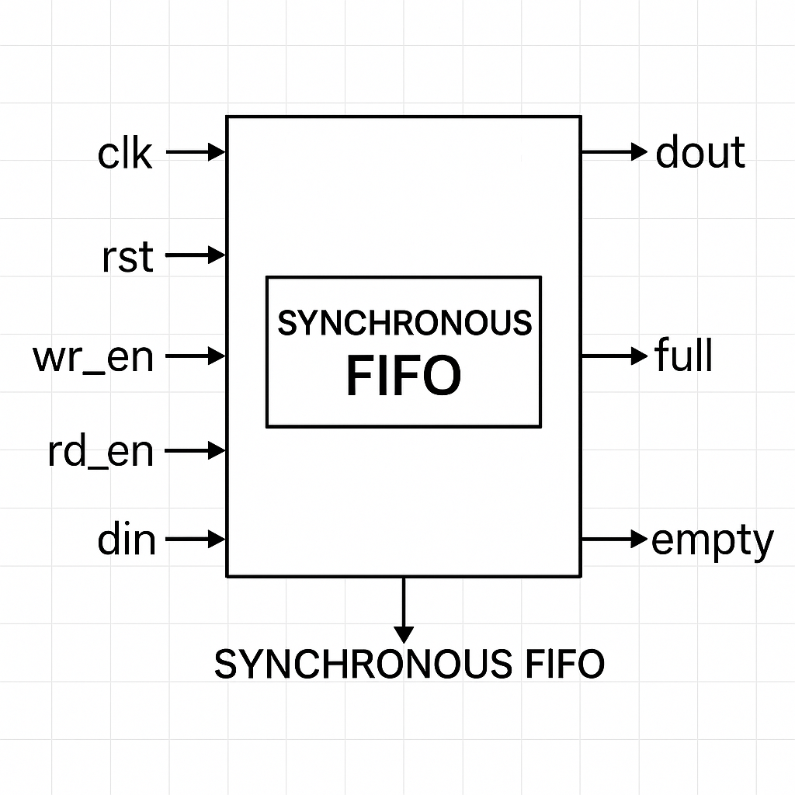
What is FIFO and Why is it Needed?
What is FIFO?
FIFO stands for First-In, First-Out. It is a memory buffer or queue where the data that is written first is read first. It is typically implemented using a circular buffer with separate read and write pointers.
Need for FIFO:
Data Rate Matching: It helps in bridging systems with different data processing rates.
Clock Domain Isolation: In asynchronous FIFOs, it allows safe data transfer between different clock domains.
Flow Control: Manages temporary storage and smoothens data flow between sender and receiver.

Slide 6
Architecture of Synchronous FIFO Memory
1. Memory Array
Acts as the data buffer.
Size: DEPTH x DATA_WIDTH (e.g., 16 x 8).
Stores data between write and read operations.
2. Control Pointers
Write Pointer (wptr): Points to the next memory location to write data. Increments on wr_en, wraps around on overflow.
Read Pointer (rptr): Points to the next memory location to read data. Increments on rd_en, wraps around on overflow.
3. Circular Buffer Logic
Both pointers operate in a circular fashion using modulo operation.
Prevents overflows and underflows by managing memory efficiently.

Slide 7
4. Counter
Tracks the number of valid entries in the FIFO.
Increases on write, decreases on read.
Drives full and empty flags:
full = (count == DEPTH)
empty = (count == 0)
5. Control Signals
clk: Synchronizes all operations.
rst: Resets FIFO state (pointers, counter, output).
wr_en: Enables writing to FIFO.
rd_en: Enables reading from FIFO.
6. Data Interface
Input (din): Data written into the FIFO.
Output (dout): Data read out from the FIFO.

Slide 8
Designing the Synchronous FIFO
Component | Function
Memory Array (memory[0:DEPTH-1]) | Holds the data entries temporarily
Write Pointer (wptr) | Points to the location where new data will be written
Read Pointer (rptr) | Points to the location from where data will be read
Counter (count) | Tracks the number of elements in the FIFO
Full/Empty Flags | Indicates FIFO status: whether it's full or empty
Control Signals (wr_en, rd_en) | Enable write and read operations

Slide 9
Working Principle
1). Write Logic
If wr_en is HIGH and FIFO is not full, data is written at wptr.
wptr is then incremented (with wrap-around using modulo).
2). Read Logic
If rd_en is HIGH and FIFO is not empty, data is read from rptr.
rptr is then incremented (circular behavior).
3). Status Logic
full = (count == DEPTH)
empty = (count == 0)

Slide 10
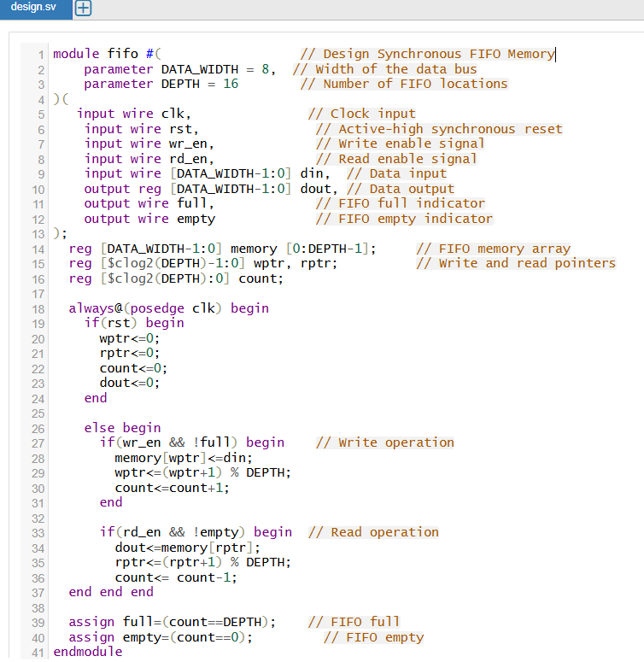

Slide 11
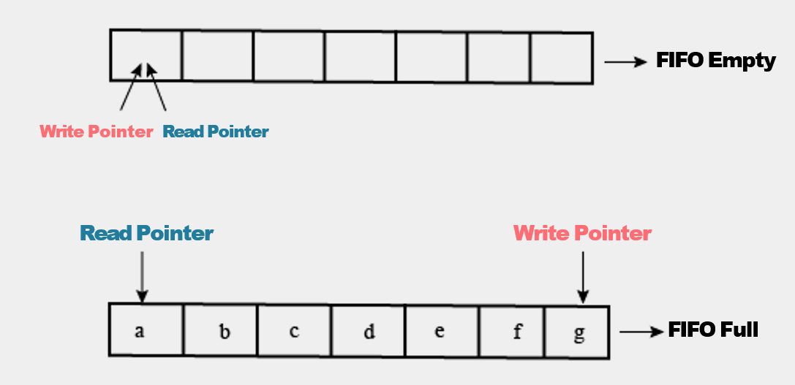

Slide 12
Testbench and Test Cases
Test Case ID | Description
TC_01 | Write operation - Check if FIFO becomes non-empty after writing
TC_02 | Read operation - Verify correct data is read
TC_03 | Full condition - Fill FIFO and check full flag
TC_04 | Empty condition - Read the only element and check empty flag
TC_05 | Single write/read - Basic data integrity check
TC_06 | Multiple writes - Fill FIFO completely
TC_07 | Multiple reads - Read back all values and verify sequence
TC_08 | Reset functionality - Confirm FIFO clears on reset
TC_09 | Overflow handling - Write after FIFO is full, ensure no write occurs
TC_10 | Underflow handling - Read from empty FIFO, ensure no invalid data
TC_11 | Wrap-around - Validate pointer wrapping using reads and writes
TC_12 | Simultaneous read/write - Test behavior with both operations active
Test Cases Included:

Slide 13
RESULTS

Slide 14
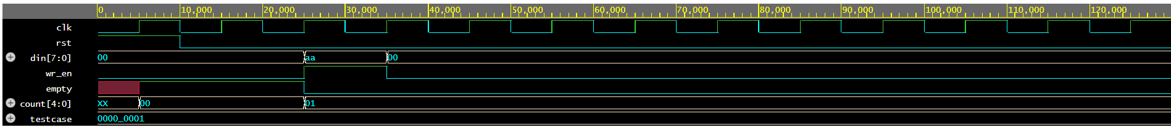

TC_01 – Write Operation Test
Write operation - Check if FIFO becomes non-empty after writing

Slide 15
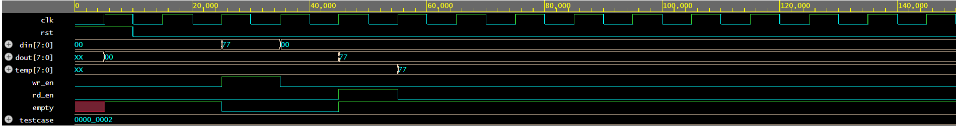

TC_02 – Read Operation Test
Read operation - Verify correct data is read

Slide 16
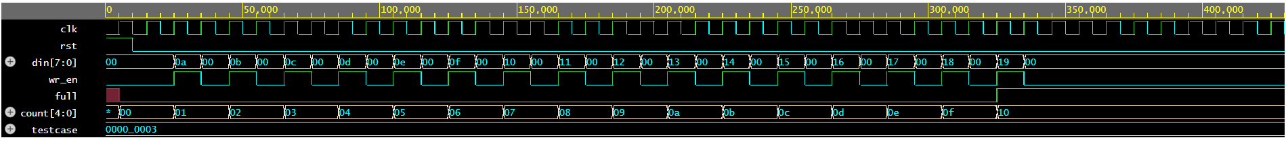

TC_03 – Full Condition Test
Full condition - Fill FIFO and check full flag

Slide 17
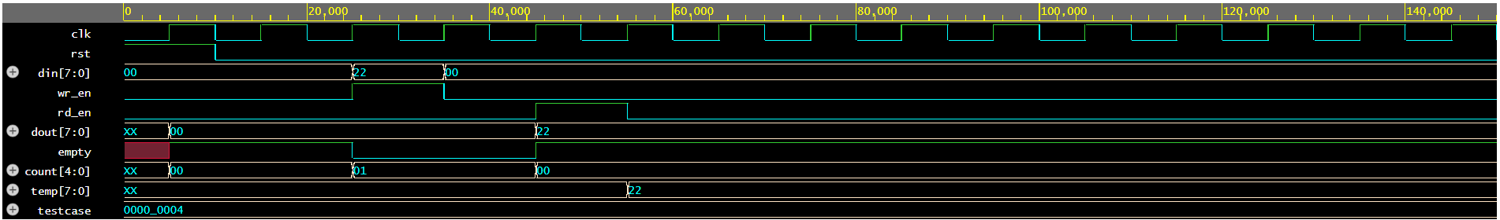

TC_04 – Empty Condition Test
Empty condition - Read the only element and check empty flag

Slide 18
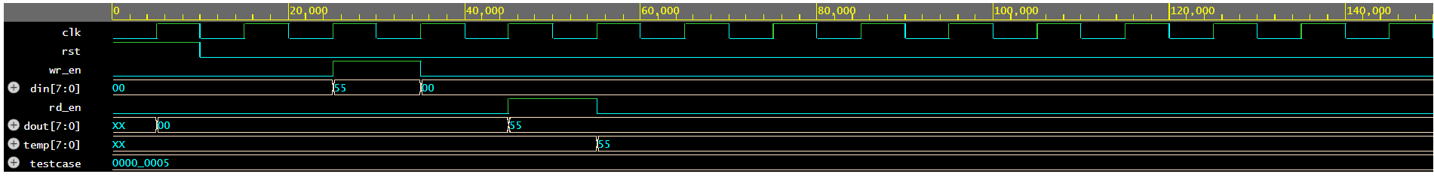

TC_05 – Single Write/Read Test
Single write/read - Basic data integrity check

Slide 19
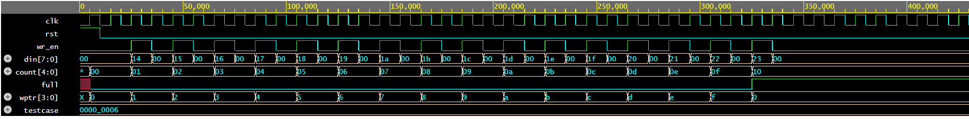

TC_06 – Multiple Writes Test
Multiple writes - Fill FIFO completely

Slide 20
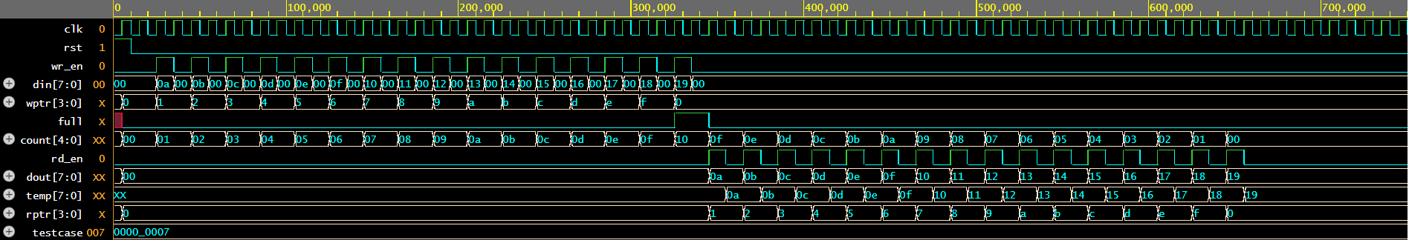

TC_07 – Multiple Reads Test
Multiple reads - Read back all values and verify sequence

Slide 21
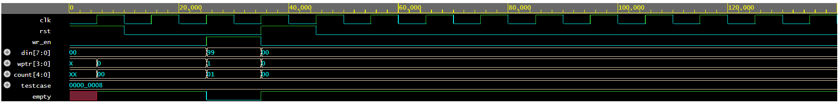

TC_08 – Reset Functionality Test
Reset functionality - Confirm FIFO clears on reset

Slide 22
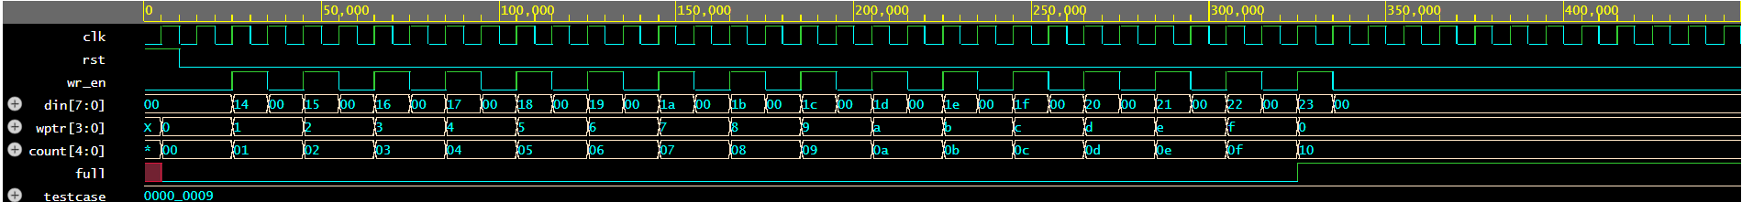
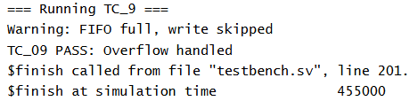
TC_09 – Overflow Handling
Overflow handling - Write after FIFO is full, ensure no write occurs

Slide 23
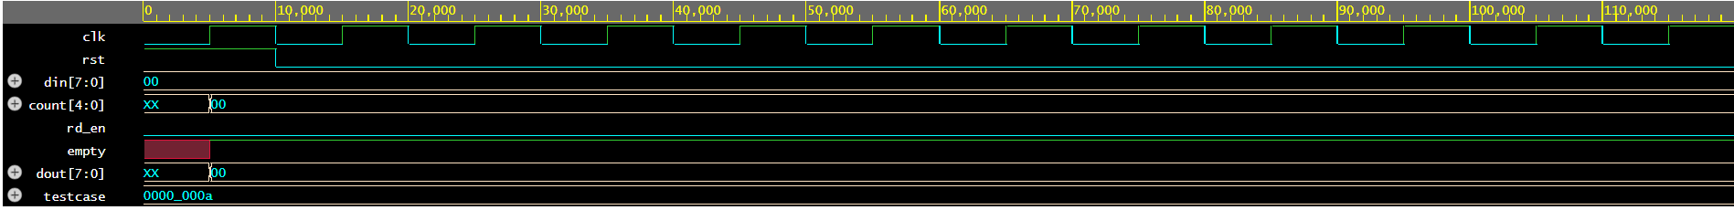

TC_10 – Underflow Handling
Underflow handling - Read from empty FIFO, ensure no invalid data

Slide 24
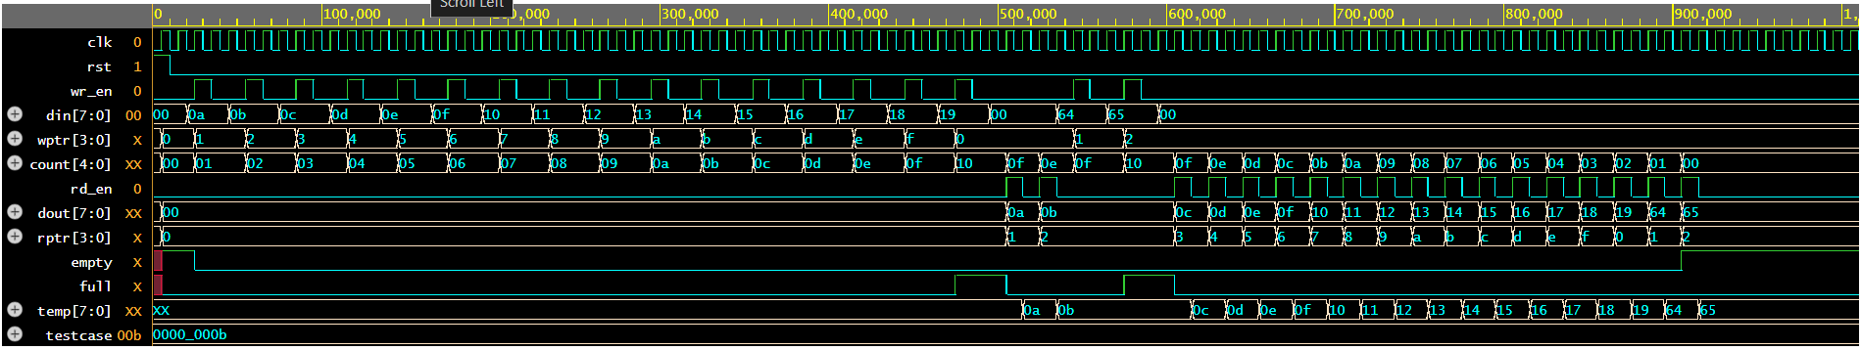

TC_11 – Wrap-Around Test
Wrap-around - Validate pointer wrapping using reads and writes

Slide 25
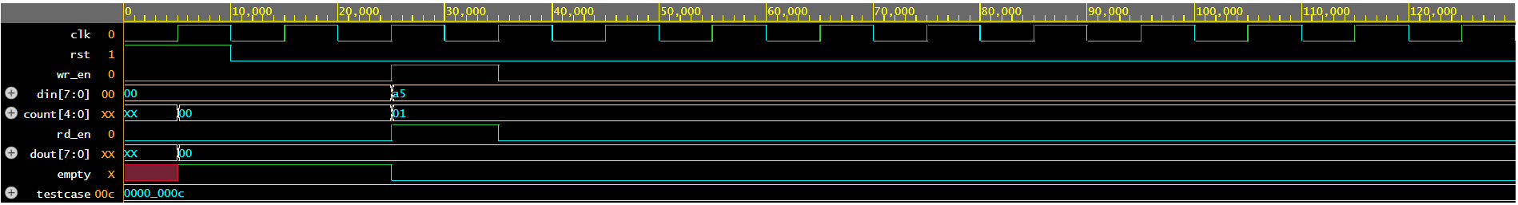

TC_12 – Simultaneous Read/Write Test
Simultaneous read/write - Test behavior with both operations active

Slide 26
Conclusion
1). Reliable Data Buffering The designed synchronous FIFO successfully enables temporary storage and transfer of data between producer and consumer modules, ensuring data integrity under a single clock domain.
2). Efficient Resource Management With circular pointer logic, status flags (full/empty), and parameterized depth/width, the FIFO design is both memory-efficient and scalable for various digital systems.
3). Verified Functionality Extensive testbench coverage through 12+ test cases (including corner cases like overflow, underflow, and wrap-around) validates the robustness and correctness of the FIFO implementation.

Slide 27
Thank You

